Slide 1
Data Analytics: Metrics, KPIs and Dashboards

Slide 2
Today
Data Analytics
Metrics and KPIs
Applichem Case
Dashboards

Slide 3
Motivation and Background
Data are everywhere!
We live in a data-rich era
Large amount of detailed data about corporate operations and individual customers are collected at an unprecedented rate
Example: Amazon, Google, Facebook, Twitter
Goal: How can we turn data into information and knowledge that will help us make better decision?
Learn about data analysis techniques and strategies for converting data to $

Slide 4
DATA ANALYSIS FOR DECISION MAKING
Data
Decision
Data to Decision
Information
Knowledge
Course topics
Exploratory Data Analysis: Dashboards
Data-Driven Marketing: Online Targeting and Segmentation via Logistic Regression and Decision Trees

Slide 5
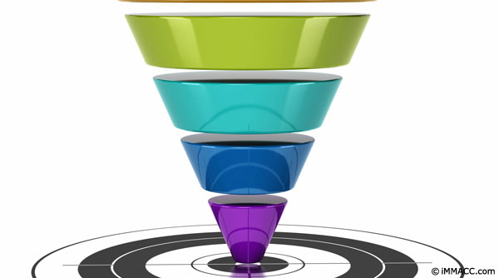
What is a metric?
A metric is anything you measure as part of the business
Distills raw data (lots of numbers) into a single number
Typically a summary statistic (average, median, standard deviation)
Ex:
Point-of-Sales Transaction Data -> Total Sales per week ($ / week)
Click-stream data -> Average # of website visits per week
Order invoices -> % of customers that place a second order within 6 months
Be specific! Units matter when defining a metric.

Slide 6
What is a KPI?
Key Performance Indicator
KPIs are a type of metric
KPIs embody a strategic objective for the firm
Distinction between KPIs and metrics is subtle
If it doesn’t tie to a strategic objective, but is still useful, it’s a metric
Examples: Are these good KPIs? What is the “strategic objective?”
Apple: Cost-per-unit-produced ( $ / unit )
Netflix: 6-month Customer attrition rate (%)
You’ve been taught dozens of metrics/KPIs in your time at Marshall. Examples?
Notes:
Accounting:
EBITDA, net Cash Flow, Net Worth
Finance:
P/E Ratio, D/ E ratio, ROI,
Ops:
Inventory turns, WIP. Throughput rate, idle time, utilization
Marketing:
Recency, Frequency,

Slide 7

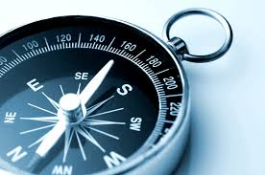
Why track KPIs and metrics?
“What gets measured, gets done”
Sets up incentives
Communicates goals to other departments
Communicates strategy externally
Can guide decision-making
Ensures firm “on-track” with its goals
Measures progress
Alerts management to potential problems early
Notes:
Quote is attributed to both Tom Peters and Peter Drucker

Slide 8
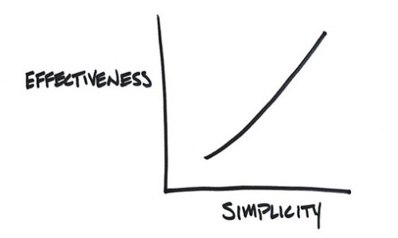
Framework I: Simplicity
Immediately understand / guess how it was calculated
Straightforward interpretation for the business
Bad Examples.
Avg. Credit Score of Loan Applicants: 645
# of defective products returned per month: 35
Notes:
Credit score is a bad example because most people have no idea how its calculated. We don’t know if 645 is a good or a bad number, so it’s hard to interpret.
#defective is a bad example because if goes down, we don’t know if quality improved, or if sales decreased…

Slide 9
Framework II: Comparative
Can you meaningfully compare this metric to same metric
Measured in the a different area of the firm
Computed at different points of time
Computed across the industry?
Does there exist a well-established, achievable target?
Requires metric is based on credible, reproducible data
Is the spot price of electricity a comparative metric?
Question: Is college GPA a comparative metric?
Notes:
This is an example of a bad metric as presented…
How do you compare across plants? Capacity? Product-Mix?

Slide 10
Framework III: Behavior-Influencing
Changes in a metric should shape behavior
What will you do as a business if this number goes up unexpectedly? Goes down unexpectedly?
Will improving this number improve your business in a meaningful way?
Examples of “not so influential” metrics:
From your reading…
If knowing this number won’t help you achieve your businesses goals, don’t bother tracking it.
Notes:
Talk about the Youtube and social philanthropy here.

Slide 11
Summary: Good metrics/KPIs are
Simple
Comparative
Behavior Influencing

Slide 12
Consider your audience…
KPIs and metrics that are useful to some members of the business are useless to others
Higher management -> more aggregated, long-term metrics
In the trenches -> more granular, short-term metrics
Ex.: Car-Dealership
CEO of GM -> Avg. Quarterly Sales
Director of Regional Sales -> Avg. Monthly Sales by Car Model by Dealership
Head of Dealership -> Weekly Sales by Car Model by Salesperson

Slide 13
Applichem Case

Slide 14
Introduction to Applichem
Applichem is a manufacturer of specialty chemicals. Their Flagship product is Release-ease specialty chemical. The company sells to its existing customer base directly.
They have four manufacturing plants in 4 regions of the world: Gary (US), Frankfurt (Germany), Mexico, and Japan.
Each of the 3 case assignments will focus on different business problems at Applichem, illustrating different data analysis techniques, and showing how these techniques can be used to solve these business problems!

Slide 15
Release Ease
It is a chemical to be added in low concentration to the plastic molding compound during its manufacture so that the molded parts would be easier to separate from the mold and would leave the mold cleaner.
Key features
Release-ease was developed by Applichem in 1952 in response to a customer's request
It was widely used in molding plastic parts
Applichem had held the patent for Release-ease, and the product family had been a steady sales and profit generator for the company through 1982
The specifications of Release-ease varied slightly among regions

Slide 16
Applichem’s business model
Revenues driven by single flagship product : Release-Ease
International supply-chain and factories
International customer base
 | Sales | Plants | Actual production | Exports by region | Imports by region
North America | 29 | Gary | 14.0 | 0 | 15
Western Europe (incl. Middle East and Africa) | 20 | Frankfurt | 38.0 | 18.0 | 0
Latin America | 12.3 | Mexico | 17.2 | 4.9 | 0
Pacific and Rest of World | 11.9 | Sunchem | 4.0 | 0 | 7.9

Slide 17
Competitive landscape
How do the US and European markets compare?
What sorts of impacts do these differences have on the business?
Market Characteristics | Europe | U.S.
Competition | Fierce | Low
Quality standards | Closely monitored | Normal
Typical Shelf-life | <1 yr | Up to 3 years
Size | 50-kilo | from 1/2-kilo on up
Notes:
Europe: Large chemical competitor.
Japan… only producer that has been approved to make product.

Slide 18
Applichem Plants
Gary Plant
Located in Gary, Indiana
Release-ease was the first product Applichem manufactured in Gary in 1982
Gary ran 8 formulations of Release-ease and about 80 package sizes
Manufactured 19 product families in addition to Release-ease
It had a total of 1,000 non-union employees
It had a Release-ease design capacity of 26 million pounds a year
Frankfurt Plant
Managed by German nationals
Made 12 product families in addition to Release-ease
The plant had 600 employees in 1982
It made about 38 million pounds of Release-ease a year
Its design capacity was 47 million pounds a year
The processes featured computer control of the first process step and extensive solids recovery and waste treatment
Mexico Plant
Managed by Mexican nationals
The plant processed about 17.2 million pounds of Release-ease during 1982
It had a design capacity of 27 million pounds a year
All its Release-ease was packaged in 50-kilo bags manufactured 6 product families in addition to Release-ease.
The process had been installed in 1968 with extra drying capacity introduced in 1978
Sunchem Plant
It was managed by Japanese nationals
Its manufacturing process had been redesigned in 1969
The Japanese plant processed many 1/2-kilo and 1-kilo packages
It produced 4 million pounds in 1982
Plant had a rated capacity of 5 million pounds a year

Slide 19
Comparing the plants
Gary Plant
8 formulations, 80 package sizes
19 other product families
1,000 non-union employees
Capacity: 26 million lbs / yr
Frankfurt Plant
Technologically advanced plant
12 other product families
600 employees
Capacity: 47 million lbs / yr
Mexico Plant
Exclusively sells 50-kilo bags
6 other product families
Less educated workforce
Capacity: 27 million lbs / yr
Sunchem Plant
Many 1/2-kilo and 1-kilo packages
High energy costs
Capacity: 5 million lbs / year
Notes:
Frankfurt – computer control of first step. Extensive waste recovery

Slide 20
Case #2: Modeling of Raw Data to Useful form for Exploratory Analysis: KPIs, Metrics and Dashboards
Applichem needs to consolidate the scattered information and the top management should get the relevant key performance indicators (KPIs) on the fly.
Currently, the unstructured data is hard to understand and manual queries result in huge delays in decision making.
Questions: Need to find an efficient way to organize company manufacturing data for efficient organization of the existing four plants.
How to leverage the information assets?
What insights can be obtained from the data?

Slide 21
KPIs for Applichem
Management spent considerable expense and time
Sharing best practices to improve efficiency
Reassessing capacity allocations across plants
Reallocating production to match demand, labor costs and foreign exchange risk
After all that, they want to make sure what’s fixed doesn’t break again
As part of the operations team, your task is to design a set of KPIs to track to alert management of significant changes in
Productivity
Labor Costs
Efficiency

Slide 22
Designing KPIs for Applichem
In a group of 2 or 3, design 3-4 KPIs to track at Applichem
Be specific. Specify units and time frames.
For example: “Track Labor Costs” is a bad answer.
For each KPI, argue it satisfies qualities of a good metric
In particular: what would you suggest to management if your KPI suddenly increased significantly? Suddenly decreased significantly?
Each group will pitch their best KPI, and we will vote as a class.

Slide 23
Dashboards

Slide 24
What is a dashboard?
Dashboards present a small set of KPIs/metrics through a simple, easy-to-understand interface
Might be numbers and words
Might be a visualization
Usually a combination
Dashboards provide a rapid, overview of the organization at a glance
Some people only use the term “dashboard” for real-time information, visualizations, or displays that fit on one page.
They use “report” otherwise.
We will use them interchangeably.

Slide 25
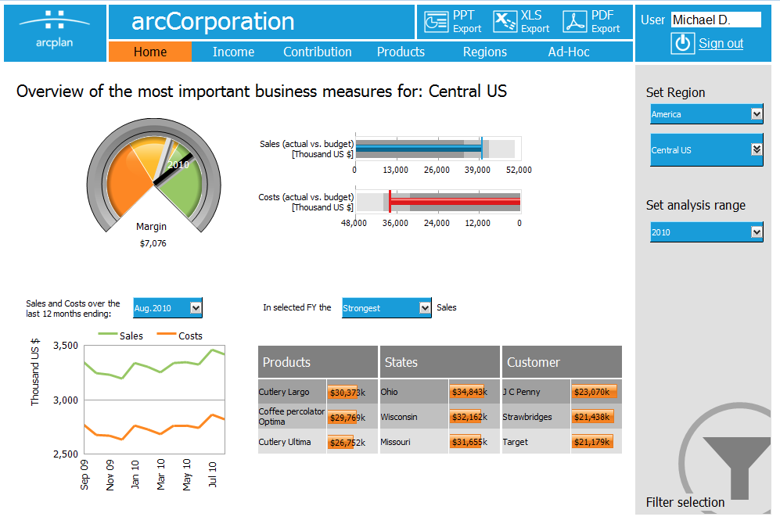
What are dashboards used for?
Overview the business rapidly
Educate departments about important objectives
Provide alerts when problems occur

Slide 26
What makes a good dashboard?
Intuitive, easy-to-understand
Aesthetically pleasing
Contains only the right metrics
Consider your audience. What decisions do they need to make?
Minimize extra details
Presents data around a theme to guide decisions and create a story
Puts metrics in context. Is this number high, low, out of the ordinary?
(Non-examinable Reading): “Guide to Dashboard Design” on BB

Slide 27
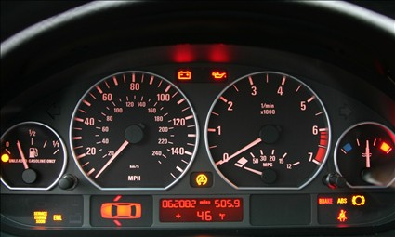
The quintessential dashboard
What are the pros/cons of this design?
Notes:
Metrics are given in context…
Size corresponds to immediate importance.
Many things are not immediately visible…
Alerts for things like Engnie light
Aesthetically pleasing?

Slide 28
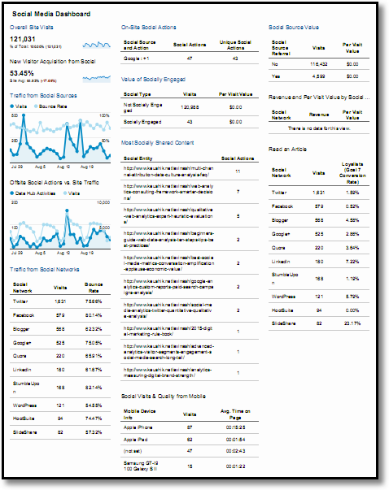
Is this a good dashboard?
Source: http://www.kaushik.net/avinash/digital-dashboards-strategic-tactical-best-practices-tips-examples/
Notes:
I’ve scaled down the resolution to make it fit…
Lot of text. Simlarly sized and organized. Where should I look?
Numbers are given without context. Nothing is emphasized.

Slide 29
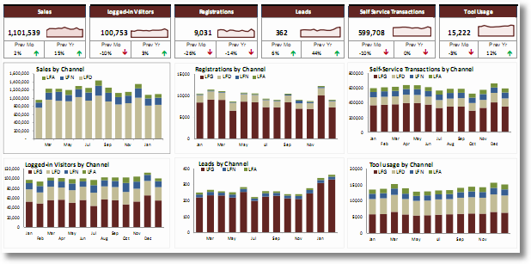
What about this?
Why?
Source: http://www.kaushik.net/avinash/digital-dashboards-strategic-tactical-best-practices-tips-examples/
Notes:
Changed numbers for pictures, but again, not clear where to look.
Some lements are better (red and green arrows for directions), still ahrd to digest at a glance. Too much information
High ink-to-page density

Slide 30
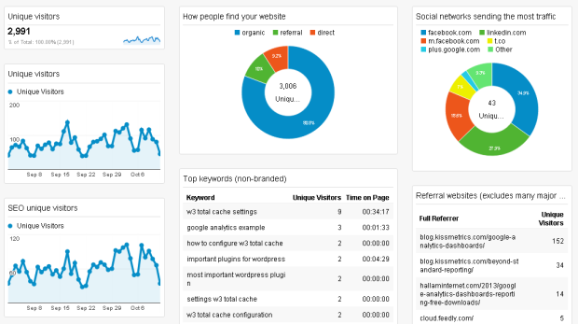
A better example
Notes:
Less information.
Low ink to page ratio.

Slide 31
Psychological elements of dashboard design
Visual aesthetics are more than just “looking” pretty
Actually affect the way we understand the data
Information Overload
Mental fatigue
Selective Attention Tests
https://youtu.be/IGQmdoK_ZfY

